Slide 1
GUI Calculator Project
Developed Using Python and the Tkinter Library
Presented By: Shiwangi Shahi
Organization : Next Hikes IT Solution

Slide 2
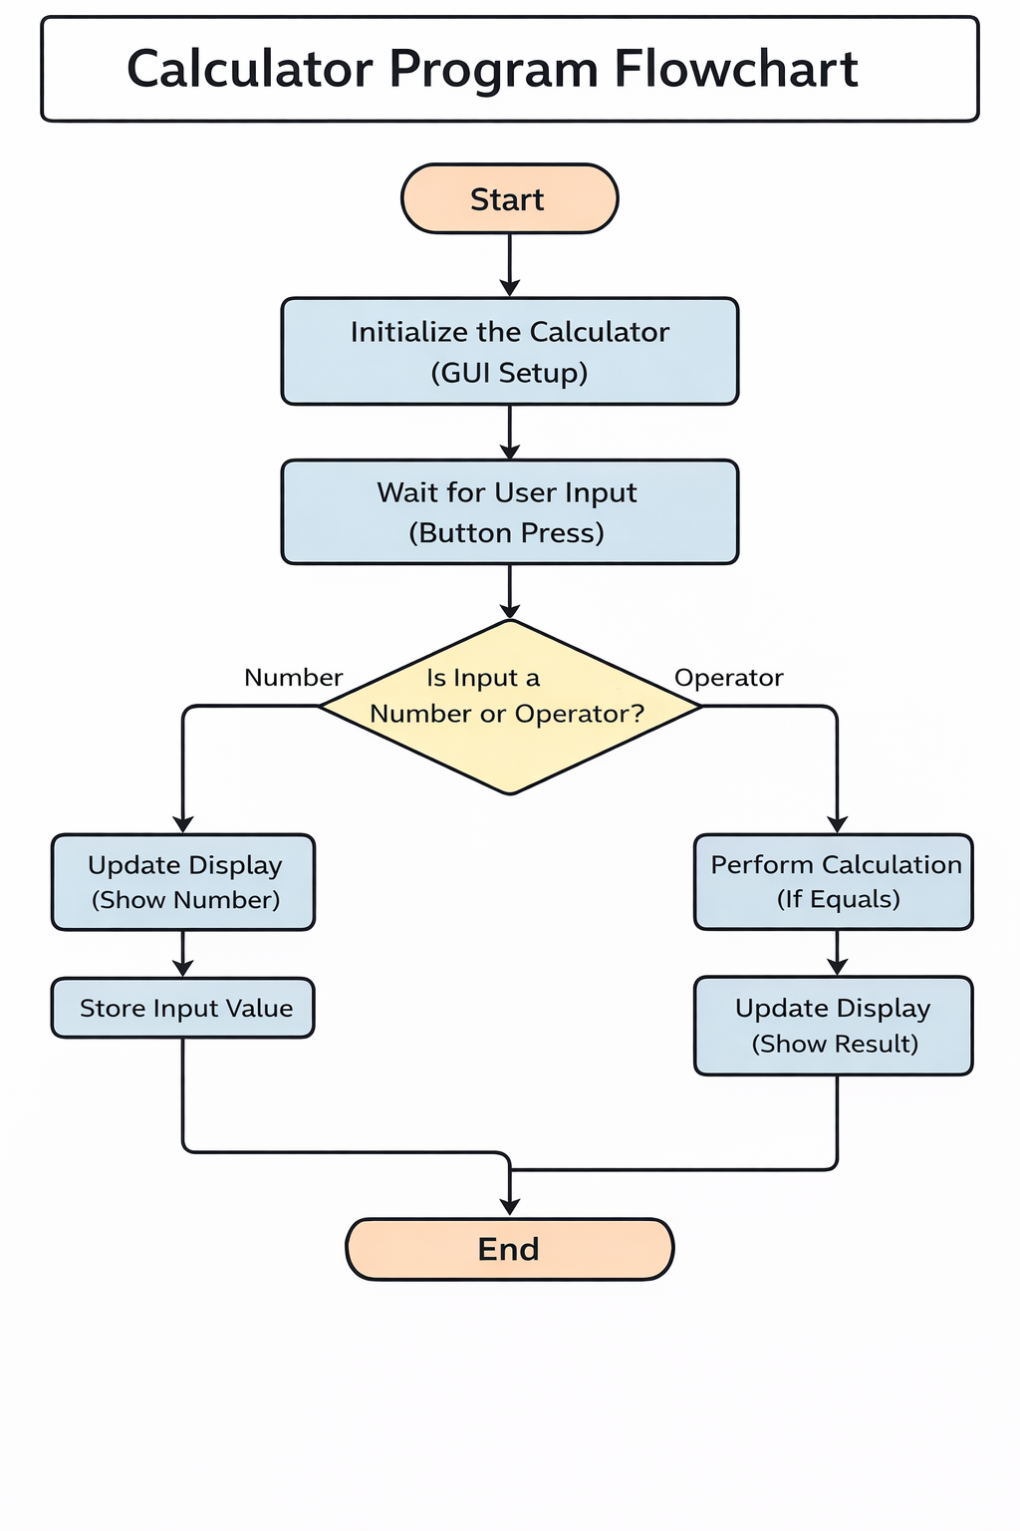
Notes:
Basic Calculator (Python – Tkinter)
Developed a GUI-based calculator using Python and Tkinter.
Performs basic arithmetic operations: Addition, Subtraction, Multiplication, Division, and Percentage.
Includes functions like AC (clear), decimal, and double zero (00).
Designed a clean and user-friendly interface with responsive buttons.
Implemented proper input handling for accurate calculations.

Slide 3
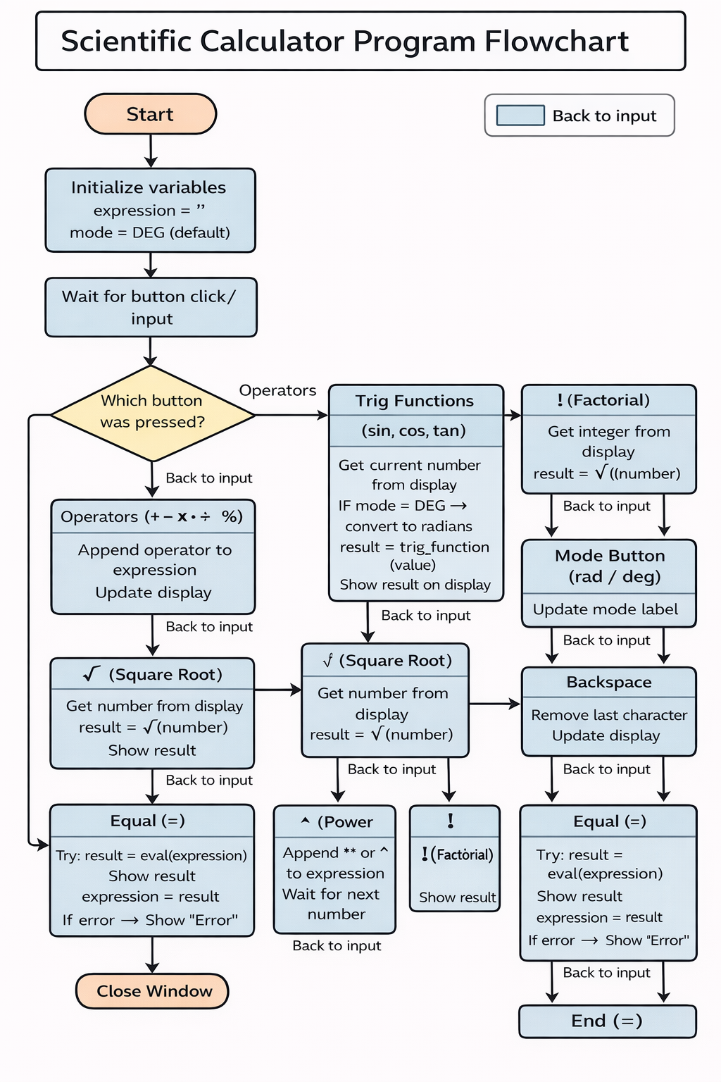
Notes:
Scientific Calculator (Python – Tkinter)
Developed a GUI-based calculator using Python (Tkinter).
Supports basic arithmetic operations: +, −, ×, ÷, %, decimal.
Includes scientific functions: √, power (^), factorial (!), sin, cos, tan.
Provides degree/radian mode selection.
User-friendly interface with clear display and responsive buttons.
Implemented input validation and error handling for accurate calculations.

Slide 4
Project Goal & Objectives
Goal:
To build a user-friendly calculator application with a graphical interface
Objectives:
Perform basic arithmetic operations
Perform scientific operations
Design GUI using Tkinter
Implement error handling (e.g., division by zero)

Slide 5
System Requirements & Tools
Programming Language: Python 3.14
GUI Library: Tkinter
Development Tools:
VS Code
Operating System:
Windows

Slide 6
Application Design & User Interface
Grid-based layout for buttons
Simple and interactive interface
Widgets used:
Tk() – Main window
Entry – Display input/output
Button – Numbers and operators
Label – Title (optional)

Slide 7
Challenges & Learnings
Challenges:
Managing invalid inputs
Handling division by zero
Managing multiple operators
Learnings:
GUI development using Tkinter
Event-driven programming
Python exception handling

Slide 8
Thank You

